Slide 1
Kobe’S SECTION
IMPORTANCES

Slide 2


gOAL
Investigate distribution of crimes per month/ week/ day
Find hotspot where there are daily crimes
Machine learning analysis in classifying crime type

Slide 3

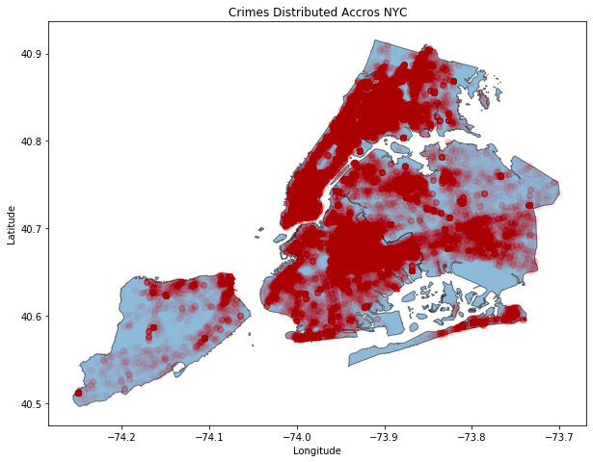
All 2019 crimes using geopandas

Slide 4
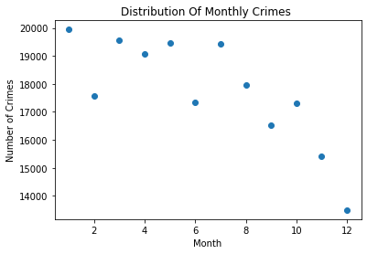
CRIME DISTRIBUTION PER MONTH

Slide 5
1 - CONTROLLED SUBSTANCE,INTENT TOBURGLARY,UNCLASS...
2 - ASSAULT 2,1,UNCLASSIFIEDPUBLIC ADMINISTATION,U...
3 - FORGERY,ETC.,UNCLASSIFIED-FELOCONTROLLED SUBST...
4 - ROBBERY,OPEN AREA UNCLASSIFIEDCRIMINAL MIS 2 &...
5 - CRIMINAL CONTEMPT 1ASSAULT 3CRIMINAL CONTEMPT ...
6 - CONTROLLED SUBSTANCE, POSSESSIROBBERY,OPEN ARE...
7 - ROBBERY,OPEN AREA UNCLASSIFIEDTRAFFIC,UNCLASSI...
8 - ASSAULT 2,1,UNCLASSIFIEDCONTROLLED SUBSTANCE, ...
9 - CRIMINAL MISCHIEF,UNCLASSIFIED 4NY STATE LAWS,...
10 - ASSAULT 3TRESPASS 3, CRIMINALNY STATE LAWS,UNC...
11 - LARCENY,PETIT FROM OPEN AREAS,INTOXICATED DRIV...
12 - IMPAIRED DRIVING,DRUGFRAUD,UNCLASSIFIED-FELONY...
TOP CRIMES PER MONTH

Slide 6
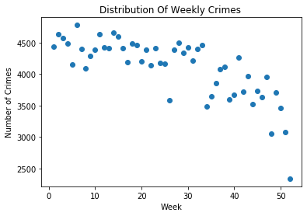
Crime distribution per week

Slide 7
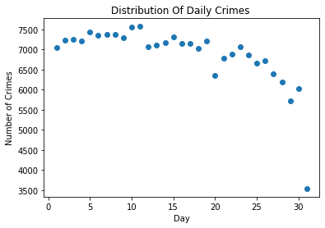
Crime distribution per day

Slide 8
Hotspot of daily crime occuerences

Slide 9
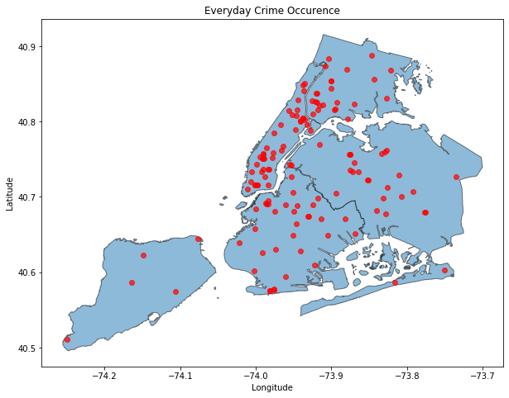
Algorithm to see where crimes occur daily
ALBEE square (BK)
Queens boulevard expressway
Rockefeller center
FULTON MALL (BK)
Gateway dr
Nostrand subway station
Jfk airport
Trans Manhattan exp
Bartow ave (coop city mall)

Slide 10
Classifying level of offense
Class type
felony
Misdemeanor
Violation
Features:
- Offense Description
- Age Group
- Race
- Gender

Slide 11
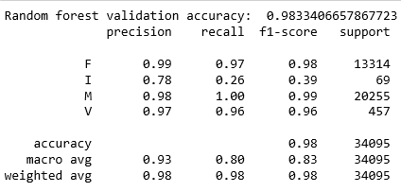
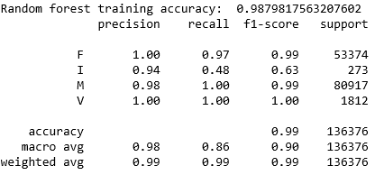
VALIDATION
TRAINING

Slide 12
Feature Importance
Offense description

